Slide 1

Network Diagrams and Activity on Node Analysis (AON)
http://worldartsme.com/images/decisionmaking-clipart-1.jpg
MGMT-3105 Lecture 6

Slide 2
Project Time Management
Project Time Management includes all the process that are needed to manage the timely completion of the project.
Plan Schedule Management
Define Activities
Sequence the activities
Estimate activity resources
Estimate activity durations
Develop schedule
Control schedule.
Today we are covering only the processes in bold Red

Slide 3
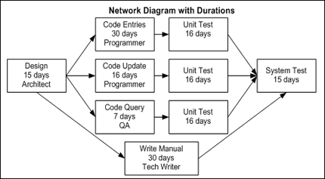
Define Activities Process
First you need to generate the Work Breakdown Structure (WBS) for the project as demonstrated. This is done by identifying all the activities that need to be completed to meet the project deliverables.
From the WBS, you need to generate the Network Activity Diagram for the project – commonly referred to as the Network Diagram.

Slide 4
WBS Review What is the definition of WBS?
A work breakdown structure (WBS) is a deliverable
oriented grouping of project components that organizes
and defines the total scope of the project.
The WBS is the project scope broken down into smaller manageable pieces or tasks. If all the tasks are completed, then the sum of those tasks will equal the project scope.
Level 1 of a WBS is the scope broken down in broad categories.
Level 2 is each of these broad categories broken down into smaller more manageable tasks or smaller categories (work packages). These tasks take between 8 and 80 hours to complete for the average project. You do not want to break tasks down below 8 hours as it becomes micromanaging at that point. Tasks more than 80 hours are too broad to manage properly.

Slide 5
Sample WBS for Project Management
1 | Fabrication and Assembly of components for tool rest (Project 275)
(Level 1) | 1 | Material
 |  | 1.1 | Material lists prepared from drawings
(Level 2) |  | 1.3 | Material Ordered
 |  | 1.5 | Material inspected upon delivery
 |  | 1.7 | Prepare material for fabrication
(Level 3) |  |  | 1.7.1 | Stock squared for base plates
 |  |  | 1.7.3 | Round stock sized for turning
 | 3 | Equipment
 |  | 3.1 | CNC 1 and 2 booked for required fabrication time
 |  | 3.3 | Lathes 1, 2 and 3 booked for required fabrication time
 | 5 | Manpower
 |  | 5.1 | Manpower availability with Fabrication Manager determined
 |  |  | 5.1.1
 |  | 5.3 | Manpower availability with Assembly Manager determined
 |  |  | 5.3.1 | Created / Posted schedule for assembly operators
 |  | 5.5 | Manpower availability with Quality Manager determined
 |  |  | 5.5.1 | Created / Posted schedule for Quality technician
 | 7 | Fabrication
 | 9 | Quality Inspections
 | 11 | Assembly
 | 13 | Quality Inspections
 | 15 | Customer Inspection
 | 17 | Packaging
 | 19 | Shipping
Create / Post schedule for Fabrication operators

Slide 6
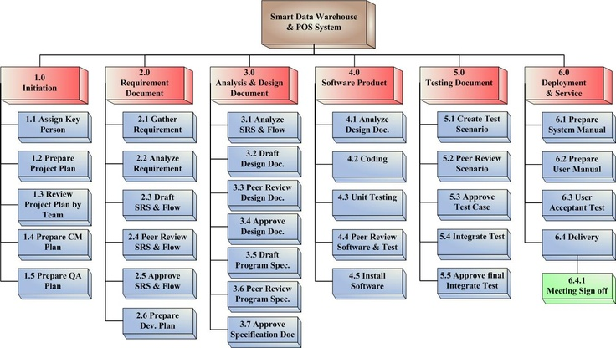
WBS Example

Slide 7
The Rules for creating Network Activity Diagrams
Some determination of activity precedence ordering must be done prior to creating the network.
Network diagrams usually flow from left to right.
An activity cannot begin until all preceding connected activities have been completed.
Arrows on networks indicate precedence and logical flow. Arrows can cross over each other, although it is helpful for clarity’s sake to limit this effect when possible.
Each activity should have a unique identifier associated with it (number, letter, code, etc.).
Looping, or recycling through activities, is not permitted.
Although not required, it is common to start a project from a single beginning node.
A single node point also is typically used as a project end indicator.

Slide 8
Key Scheduling Terminology - simplified
Activity:
Scope: The work content and products of a project.
Work Breakdown Structure (WBS): A task-oriented grouping of activities that organizes, defines, and graphically displays the total work to be accomplished in order to achieve the final objectives (deliverables) of the project.
Work Package: A deliverable at the lowest level of the work breakdown structure.
Project Network Diagram: Any schematic display of the logical relationships of project activities.
Path: A sequence of activities defined by the project network logic.
Early Start Date (ES): The earliest possible date on which the uncompleted portions of an activity can be started.
Late Start Date (LS): The latest possible date that an activity may begin without delaying a specified milestone.

Slide 9
Key Scheduling Terminology – simplified (cont.)
Early Finish
Late Finish
Forward Pass – Network calculations that determine the earliest start/finish time for each activity.
Backward Pass – Calculation of late start and late finish times for all uncompleted network activities.
Event – A point in time when an activity is either started or completed.
Node – One or more defining points of a network.
Predecessors – Those activities that must be completed prior to an activity in the network.
Successors – Activities that cannot be started until previous activities have been completed.
Merge Activity – An activity with 2 or more immediate predecessor activities flowing into it.

Slide 10
Key Scheduling Terminology – simplified (cont.)
Burst Activity: An activity with 2 or more immediate successor activities flowing out from it.
Float (Slack): The amount of time an activity may be delayed from its early start without delaying the finish of the project.
Critical Path: The path through the project network with the longest duration.
Critical Path Method: A network analysis technique used to determine which sequence of activities (which path) has the least amount of scheduling flexibility and therefore will most likely determine when the project can be completed.

Slide 11
Key Scheduling Terminology – simplified (cont.)
Resource Limited Schedule: A project schedule whose start and finish dates reflect expected resource availability.
Program Evaluation and Review Tool (PERT): An event and probability-based network analysis system generally used in projects where activities and their durations are difficult to define.

Slide 12
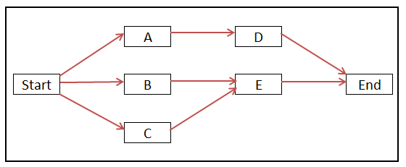
Labels for Activity Nodes
ES | Earliest Start |  | DUR | Duration of Activity
EF | Earliest Finish |  | FLT | Float
LS | Latest Start
LF | Latest Finish

Slide 13
Defining the numbers
1) Do the Forward Pass first to determine ES and EF
2) Do a Backwards Pass next to determine LF and LS
3) Subtract ES from LS to determine FLOAT

Slide 14

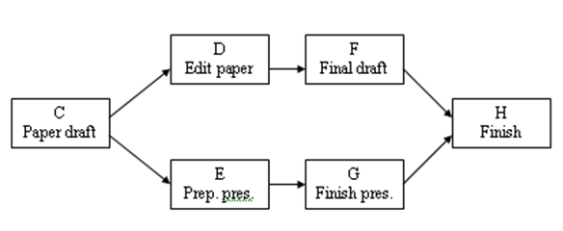
Series/Parallel Activities
Series
Parallel

Slide 15
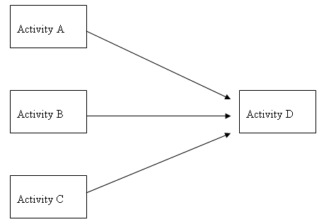
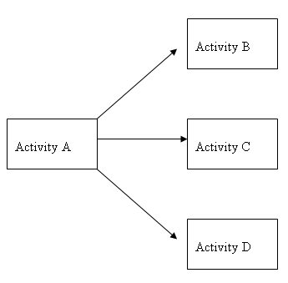
Activities Merge / Burst
Merge
Burst

Slide 16
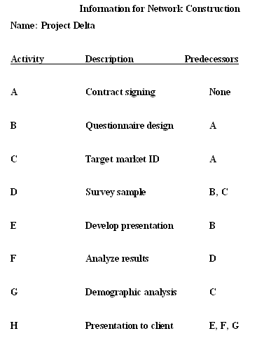
Creating a Project Network Activity Diagram - Example

Slide 17
Activity on Node Network

Slide 18
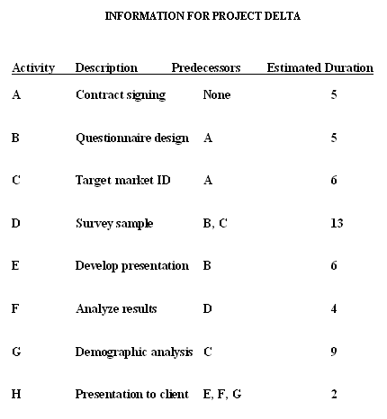
Constructing the Critical Path

Slide 19
Project Activity Network Showing Project Durations

Slide 20
Rules when using the Forward Pass
Add all activity times along each path as we move through the network (ES + Duration = EF)
Carry the EF time to the activity nodes immediately ahead of the previous completed node. That EF becomes the ES of the next node, unless the next node is a merge point.
At a merge point, the largest previous EF becomes the ES for that node

Slide 21
Activity Network with Forward Pass

Slide 22
Rules when using the Backward Pass
Subtract activity times along each path as you move through the network (LF – Dur = LS)
Carry back the LS time to the activity nodes immediately before the next node. That LS becomes the LF of the previous node, unless the previous node is a burst point.
In the case of a burst point, the smallest following LS becomes the LF for that node.

Slide 23
Activity Network with Backward Pass

Slide 24
Completed Network Activity Diagram with Critical Path and Slack Times Calculated
LS – ES or LF – EF = the Float. Activities that have a zero float cannot be delayed without delaying the entire project. These tasks together form the critical path.
Critical Path in bold

Slide 25
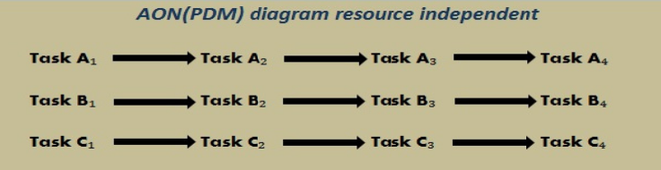
Network Activity Diagram example that Illustrates Laddering technique
If Tasks A1,B1 and C1 do not need the same resources then they could run simultaneously.

Slide 26
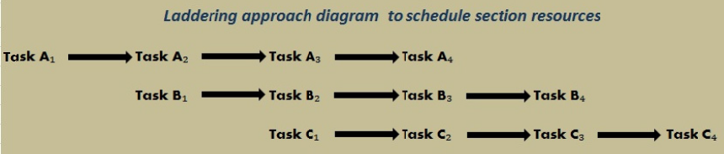
Network Activity Diagram example that Illustrates Laddering technique
If Tasks A1, B1 and C1 need the same resources then they could run in a laddered start. That way once Task A1 was completed with the resource, Task B1 could then use it and then Task C1.

Slide 27
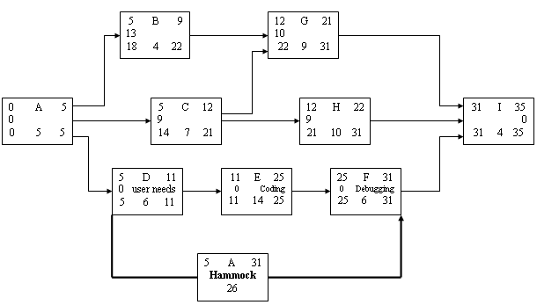
Network Activity Diagram example that Illustrates Hammocking technique
Hammocking activities can be used as summaries for diagram segments of series activities. This allows for a smaller diagram that is less confusing.

Slide 28
Steps to Reduce the Critical Path
Eliminate tasks on the Critical Path
Re-plan series paths to be parallel
Overlap sequential tasks
Shorten the duration on critical path activities
Shorten earlier starting tasks
Shorten longest tasks
Shorten easiest tasks
Shorten tasks that cost the least to speed up.

Slide 29
Activity Duration Estimating
There are several methods:
Expert judgment estimating: Guided by historical information this can be used whenever possible.
Analogous estimating: A method of estimating that employs using a similar activity from a previous project as the basis for establishing the likely duration of a future schedule activity.
Parametric estimating: The quantity of work divided by the productivity rate. For example, total labor hours divided by man hours per day, or cable installation in meters of cable divided by meters per hour.
Reserve analysis estimating: An output of risk analysis, it can be employed to add empty buffers in project timing to deal with risk as part of a contingency plan.
Three point Method: PERT (Program Evaluation Review Technique)

Slide 30
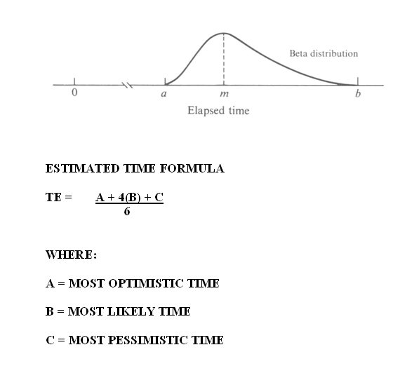
Activity Duration Estimate – PERT Estimate

Slide 31
Pert Example
Calculate the estimated time to complete each of the following tasks.

Slide 32
Pert Example
Calculate the estimated time to complete each of the following tasks.
14.83
10
19
12.83
26.33

Slide 33
AON Example 1
Activity | Predecessors | Duration (days)
A | None | 5
B | A | 8
C | B | 3
D | A | 4
E | C | 5
F | C | 7
G | D, E | 6
H | F | 8
I | G | 6
J | H, I | 5

Slide 34
AON Example 1
Activity | Predecessors | Duration (days)
A | None | 5
B | A | 8
C | B | 3
D | A | 4
E | C | 5
F | C | 7
G | D, E | 6
H | F | 8
I | G | 6
J | H, I | 5

Slide 35
AON Example 2
Activity | Predecessors | Duration (days)
A | None | 3
B | A | 4
C | A | 2
D | B | 5
E | C | 1
F | E | 2
G | D, E | 4
H | F, G | 3
I | H | 6

